Slide 1
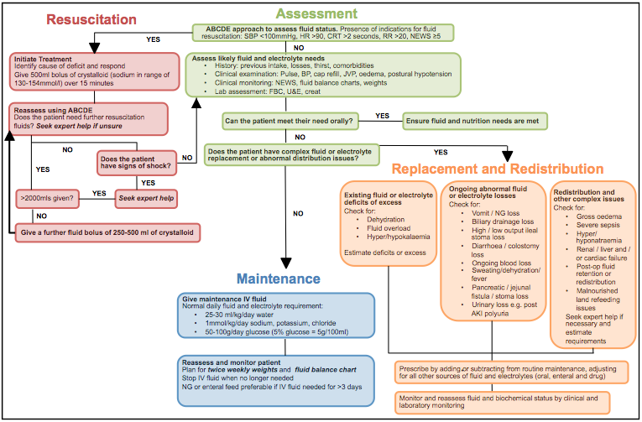
Front
Back
Figure 1: IV Fluid Prescribing Lanyard Card

Slide 2
Pre-Intervention
Post-Intervention
Average score
Figure 2: Improving IV Fluid Prescribing: Run-through graph of SEAU data

Slide 3
Pre-Intervention
Post-Intervention
Average score
Figure 3: Improving IV Fluid Prescribing: Run-through graph of MEAU data

Slide 4
Figure 4: How well are we prescribing IV fluids?
Proportion of patients with "IV Fluid Prescription Bundle" requested

