Slide 1
Post Intervention Results 1

Slide 2
Post Intervention Results 2

Slide 3
Post Intervention Results 3

Slide 4
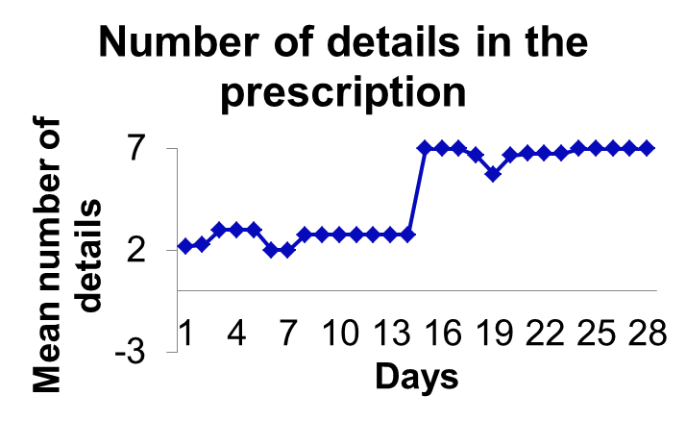
Post Intervention Results 4

Slide 5
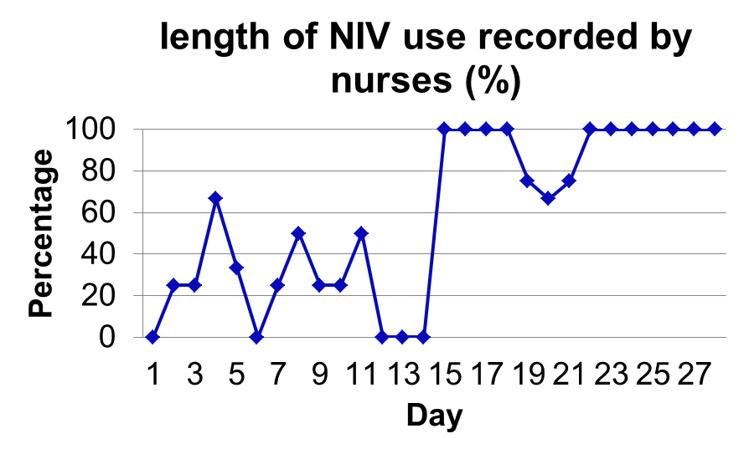
Post Intervention Results 5

